Slide 1
Autohausen
By Nick Collins

Slide 2
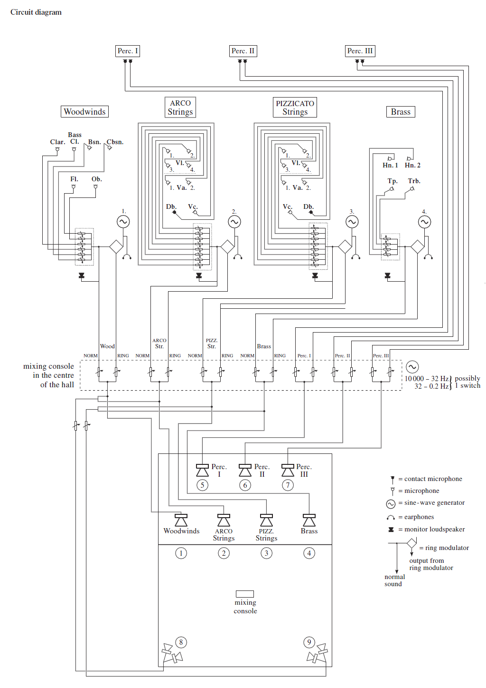
How it works
This code uses three SynthDefs or instruments to define its sound and makes the code works on when the sound is triggered and how to be triggered. In this format, it creates algorithmic composition or generative music like the creative process of stockhausen's music.

Slide 3
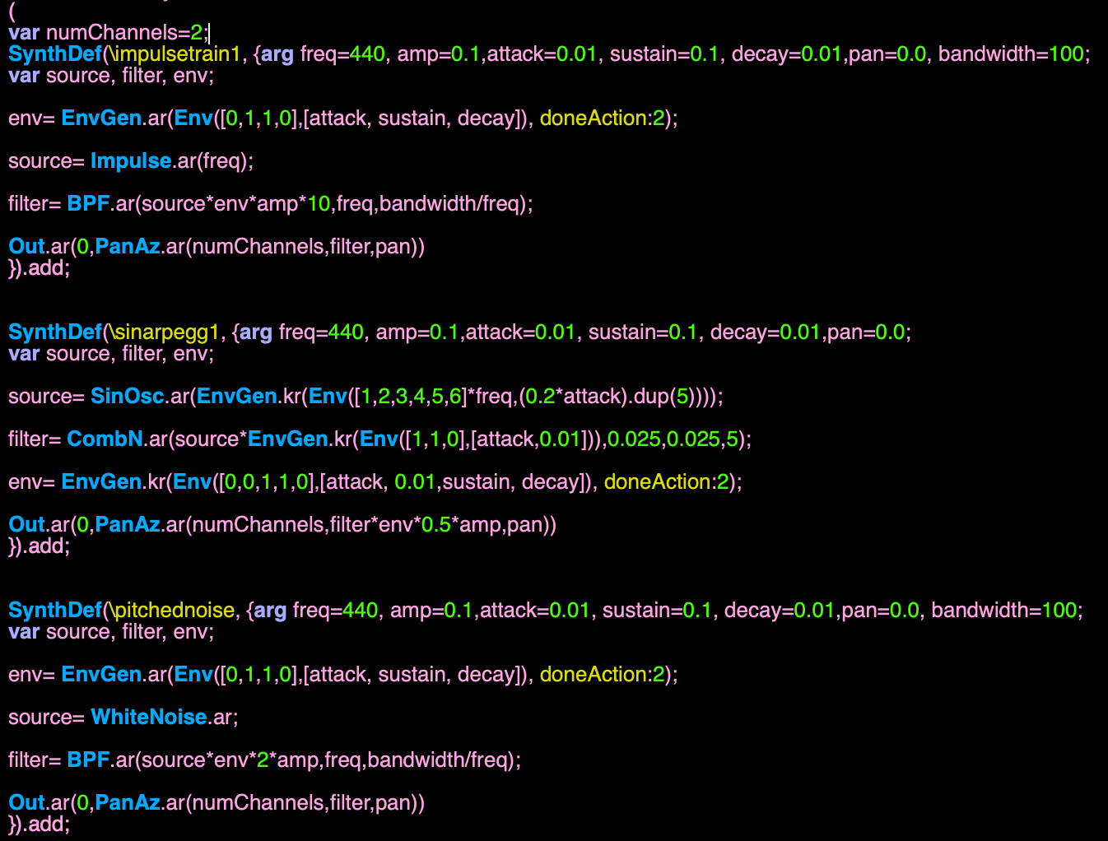
Sounds/synthdefs
/instruments
\impulsetrain1
Creates low and high frequencypulse by using BPF (band pass filter) to make its timber chained with its own frequency. This makes a metalic pulse sound.
\sinarpegg1
It's a SinOsc using a envelope as a frequency input, and " [1,2,3,4,5,6] * freq" makes a arpeggio or glissando effects, and with CombN (Comb Filter) to add a slight delay or special reverb sound.
\pitchednoise
This one also uses BPF but it's more about making white noise sound into wind sound, adding a airy texture with pitch to this music.

Slide 4
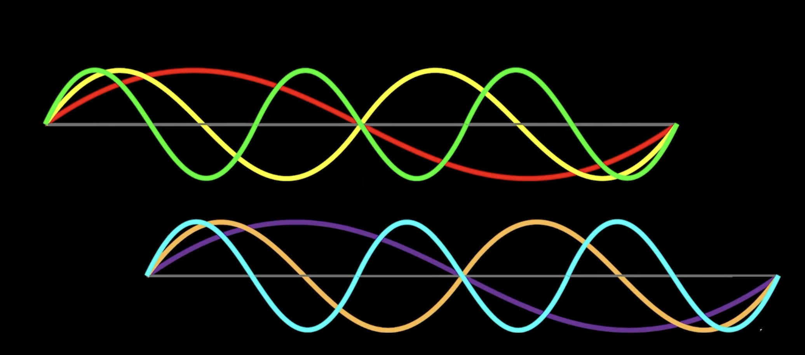
Important techniques
PanAz
PitchShift
Handmade Reverb/Space
"Out.ar(0,PanAz.ar(numChannels,filter,pan)) "
It allow this piece to have 4 audio channels instead of a stereo output to make it sound more like stockhausen's style.
" shifted= PitchShift.ar(input, 0.01,rate); "
is to simulate slow down, like in Tape music or music concrete,
and "[1,0.5,0.25,0.125,4].choose" allows to choose different slow rate.
"DelayN" as pre-delay
"CombL" as comb reverberators
"AllpassN" as diffuse network (Schroeder allpass delay line with no interpolation.)

Slide 5
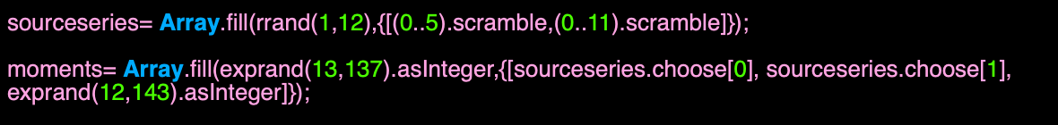
Music structure/system
Sourceseries and moments
"sourceseries= Array.fill(rrand(1,12),{[(0..5).scramble,(0..11).scramble]}); "
contain two array of (0...5) and (0...11), and
moments= Array.fill(exprand(13,137).asInteger,{[sourceseries.choose[0], sourceseries.choose[1], exprand(12,143).asInteger]});
decide how many times to trigger the array or events.
ioiseries
ioiseries= Pseq(0.025+(6**((seriesseries2.copy.flatten.at((0..143)).rotate(144.rand)+1)/12)-1),inf).asStream;
determine how long between arrays and events.
instrseries
instrseries= Pseq([\pitchednoise,\impulsetrain1,\sinarpegg1].dup(6).flatten.scramble,inf).asStream;
Decide which SynthDef it's gonna be triggered.

Slide 6
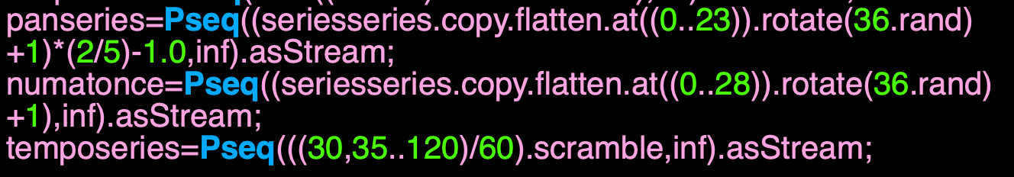
Music structure/system
panseries
panseries=Pseq((seriesseries.copy.flatten.at((0..23)).rotate(36.rand)+1)*(2/5)-1.0,inf).asStream;
Control panning with different movement.
numatonce
numatonce=Pseq((seriesseries.copy.flatten.at((0..28)).rotate(36.rand)+1),inf).asStream;
Control numbers of voices that's happeing simultaneously or just in a single time.
temposeries
temposeries=Pseq(((30,35..120)/60).scramble,inf).asStream;
We can choose the range of tempo and the method of choosing.

Slide 7
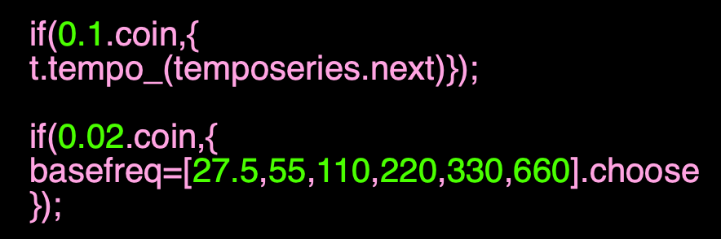
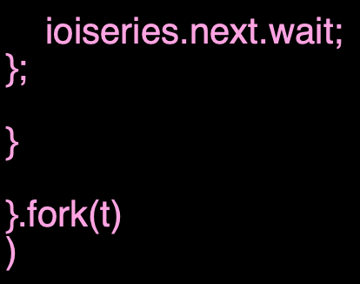
Music structure/system
tempo and basefreq
if(0.1.coin,{
t.tempo_(temposeries.next)});
if(0.02.coin,{
basefreq=[27.5,55,110,220,330,660].choose
});
Changing tempo and harmonic/pitch field by probablity
Tempo: 10%
Basefreq; 2% (base on bass center)
.fork(t) and .wait
}.fork(t)
Use TempoClock (schedules relative to a tempo in beats per second.)
ioiseries.next.wait;
And wait between arrays and events.

Slide 8
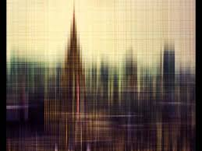
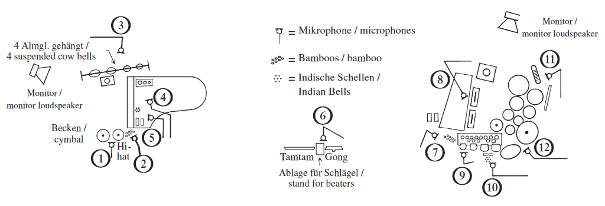
Aesthetic influence
Karlheinz Stockhausen: Telemusik (1966)
Karlheinz Stockhausen: Mixtur (1964)
KONTAKTE (Stockhausen)

Slide 9
Thank you ~

